Slide 1

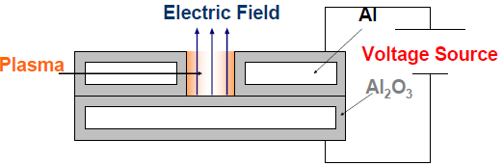
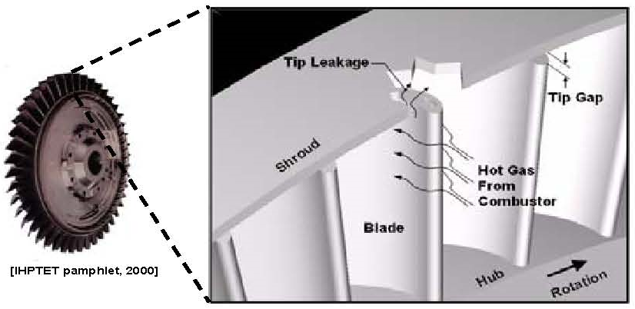
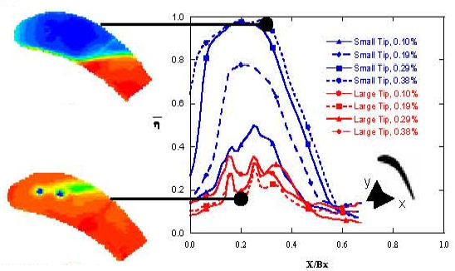
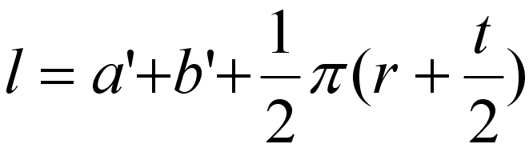
Başvuru No
Afyon Kocatepe Üniversitesi
Kocatepe Ar-Ge Proje Pazarı
14-15 Mayıs 2025 , Afyonkarahisar
Poster Başlığı , Calibri, 96 points, Bold
Yazar 1, Yazar 2, Calibri, 60 Points, Bold
ÖZET, Calibri, 54 points, bold
Text in Calibri, 40 points, Bold. Text in Calibri, 40 points, Bold. Text in Calibri, 40 points, Bold. Text in Calibri, 40 points, Bold. Text in Calibri, 40 points, Bold. Text in Calibri, 40 points, Bold. Text in Calibri, 40 points, Bold. Text in Calibri, 40 points, Bold. Text in Calibri, 40 points, Bold. Text in Calibri, 40 points, Bold.
Anahtar Kelimeler: Caption in Calibri, 36 points, bold.
YÖNTEM/MATERYAL ve METOT, Calibri, 54 points, bold
Text in Calibri, 40 points, Bold. Text in Calibri, 40 points, Bold. Text in Calibri, 40 points, Bold.. Text in Calibri, 40 points, Bold. Text in Calibri, 40 points, Bold. Text in Calibri, 40 points, Bold.. Text in Calibri, 40 points, Bold. Text in Calibri, 40 points, Bold. Text in Calibri, 40 points, Bold..
AMAÇ/ÖZGÜN DEĞER, Calibri, 54 points, bold
Text in Calibri, 40 points, Bold. Text in Calibri, 40 points, Bold. Text in Calibri, 40 points, Bold. Text in Calibri, 40 points, Bold. Text in Calibri, 40 points, Bold. Text in Calibri, 40 points, Bold. Text in Calibri, 40 points, Bold. Text in Calibri, 40 points, Bold. Text in Calibri, 40 points, B
Resim 2. Yazı stili calibri, yazı boyu 38 ve resim 300 dpi kalitesinde olacaktır.
SONUÇ, Calibri, 54 points, bold
Text in Calibri, 40 points, Bold. Text in Calibri, 40 points, Bold. Text in Calibri, 40 points, Bold. Text in Calibri, 40 points, Bold. Text in Calibri, 40 points, Bold. Text in Calibri, 40 points, Bold. Text in Calibri, 40 points, Bold. Text in Calibri, 40 points, Bold.
Resim 1. Yazı stili calibri, yazı boyu 38 ve resim 300 dpi kalitesinde olacaktır.
YÖNTEM/MATERYAL ve METOT, Calibri, 54 points, bold
Text in Calibri, 40 points, Bold. Text in Calibri, 40 points, Bold. Text in Calibri, 40 points, Bold..
Resim 3. Yazı stili calibri, yazı boyu 38 ve resim 300 dpi kalitesinde olacaktır.
.
REFERANSLAR, Calibri, 54 points, bold
Text in Calibri, 40 points, Bold. Text in Calibri, 40 points, Bold. Text in Calibri, 40 points, Bold.

